Slide 1
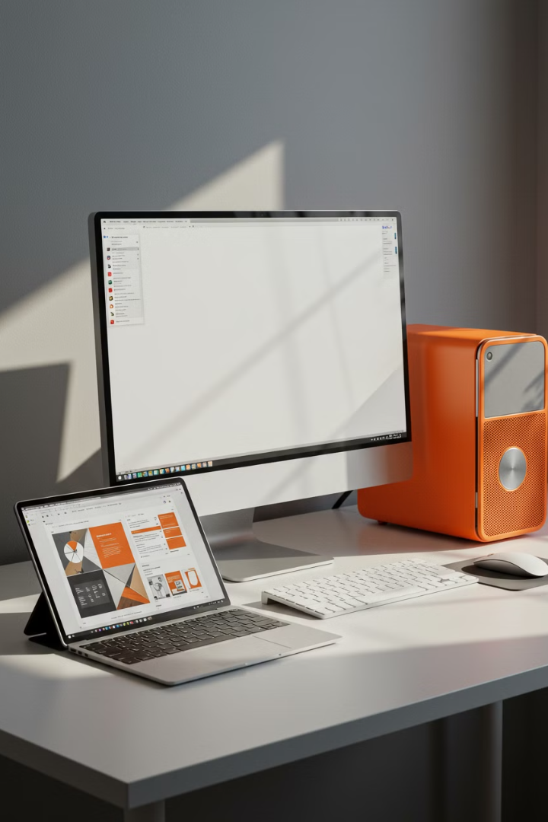

Best Computer for Beginners : Desktop vs Laptop vs Tablet
If you're new to computers and wondering which one to choose, you have three main options: a desktop, a laptop, or a tablet. Each has its own advantages and disadvantages, depending on what you need. Let's break it down in
simple terms to help you decide:
by Ram N Java

Slide 2
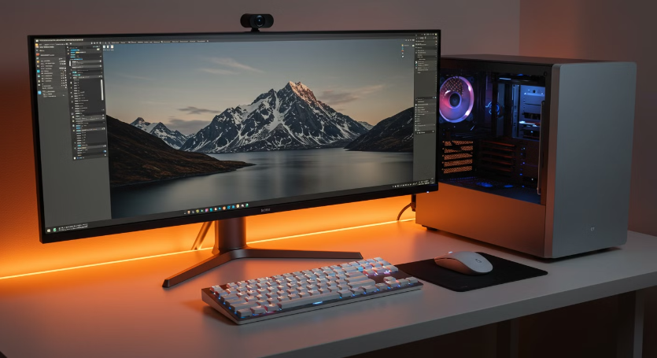
Desktop Computer
What is it?
A desktop is a large computer that stays in one place. It has a separate monitor, keyboard, mouse, and CPU (the main box).
Pros
Powerful: Desktops are usually more powerful than laptops or tablets, making them great for heavy tasks like gaming or video editing.
Easy to Upgrade: You can easily add more memory, storage, or a better graphics card.
Big Screen: The monitor is usually large, making it easier to see and work on.
Comfortable: You can use a full-sized keyboard and mouse, which are more comfortable for typing and clicking.
More Durable – Less risk of damage compared to laptops and tablets.

Slide 3
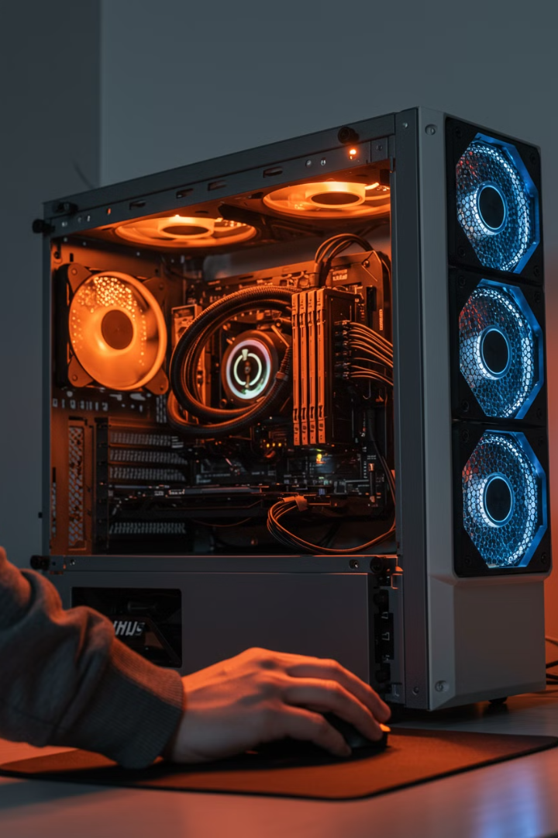
Desktop Computer
Cons
Not Portable: You can't carry it around because it's big and needs to stay in one place.
Takes Up Space: It requires a desk or table and can be bulky.
Requires Power Plug – Cannot run on battery.
Best For
People who need a powerful computer for work, gaming, or creative tasks and don't need to move it around.

Slide 4





Laptop
What is it?
Portable
All-in-One
A laptop is a portable computer with a built-in screen, keyboard, and trackpad. It's like a desktop but smaller and easier to carry.
You can take it anywhere – to school, work, or a coffee shop.
It has everything built in (screen, keyboard, and mouse), so you don't need extra parts.
Battery Powered
You can use it without plugging it in for a few hours.
Good for Everyday Use: Laptops are great for browsing the internet, writing documents, and watching videos.

Slide 5
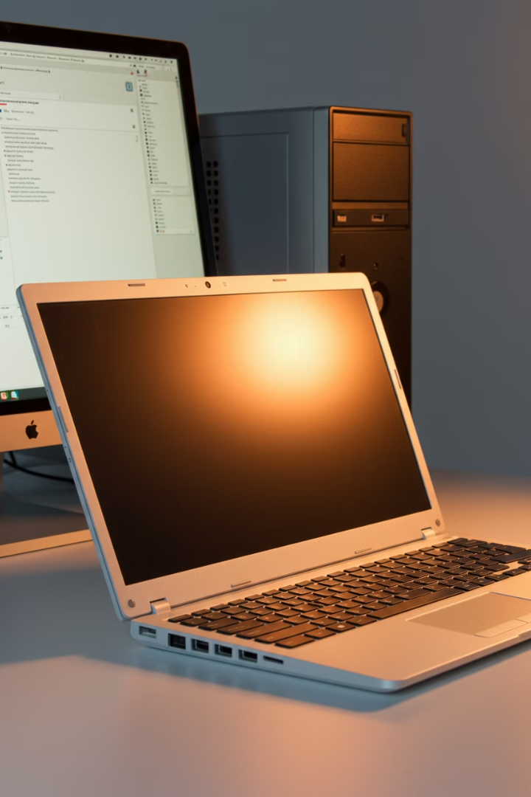
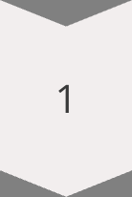
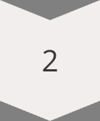
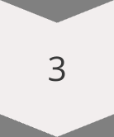
Laptop
Cons
Less Powerful Laptops are usually less powerful than desktops, especially for heavy tasks like gaming or video editing.
Harder to Upgrade
It's not easy to upgrade parts like the CPU or graphics card.
Smaller Screen
The screen is smaller than a desktop monitor.
Best For
People who need a portable computer for school, work, or everyday tasks.

Slide 6





Tablet
What is it?
Very Portable
Touchscreen
A tablet is a small, touchscreen device that's even more portable than a laptop. It's like a big smartphone.
You can easily carry it in a bag or even hold it in your hands.
It's easy to use with your fingers or a stylus (a special pen).
Great for Media
Long Battery Life
Tablets are perfect for watching videos, reading books, or browsing the internet.
Tablets usually last longer on a single charge compared to laptops.

Slide 7
Tablet
Limited Power
1
Tablets are not as powerful as desktops or laptops, so they're not great for heavy tasks.
Small Keyboard
2
Typing on a touchscreen can be harder than using a physical keyboard.
Fewer Features
3
Tablets don't have as many features as laptops or desktops.
Cannot Run All Software – Some apps don't work like they do on a laptop or desktop.
Best For
People who want a lightweight device for entertainment, reading, or basic tasks.

Slide 8
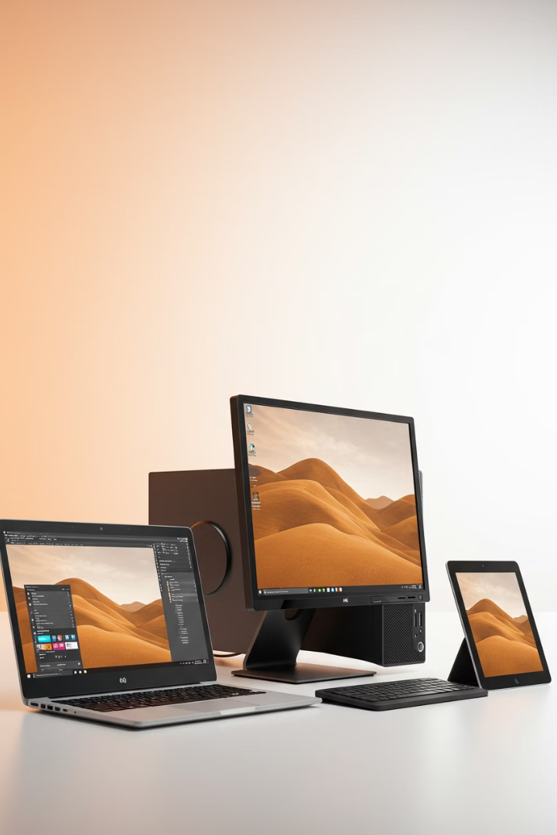
Comparison Table
Feature
Desktop
Laptop
Tablet
Portability
Not portable (stays in one place).
Portable (easy to carry).
Very portable (fits in a bag).
Power
Most powerful.
Less powerful than desktop.
Least powerful.
Screen Size
Large screen.
Medium screen.
Small screen.
Typing
Full-sized keyboard (comfortable).
Built-in keyboard (smaller).
Touchscreen keyboard (harder).
Best For
Heavy tasks (gaming, editing).
Everyday tasks (school, work).
Entertainment (videos, books).

Slide 9
Which One Should You Choose?
Choose a Desktop if:
Desktop Lifestyle
Choose a Laptop if:
You need a powerful computer for gaming, video editing, or heavy work.
You don't need to move
it around.
You need a portable computer for school, work, or everyday tasks.
Laptop Lifestyle
Choose a Tablet if:
You want something that's easy to carry but still powerful.
You want a lightweight device for watching videos, reading, or basic tasks.You don’t need a lot of power or features.

Slide 10






Summary
Desktop
Best for power and heavy tasks, but not portable.
Laptop
Best for portability and everyday tasks.
Tablet
Best for entertainment and light use.
Think about what you need the computer for, and choose the one that fits your lifestyle!

